Slide 1
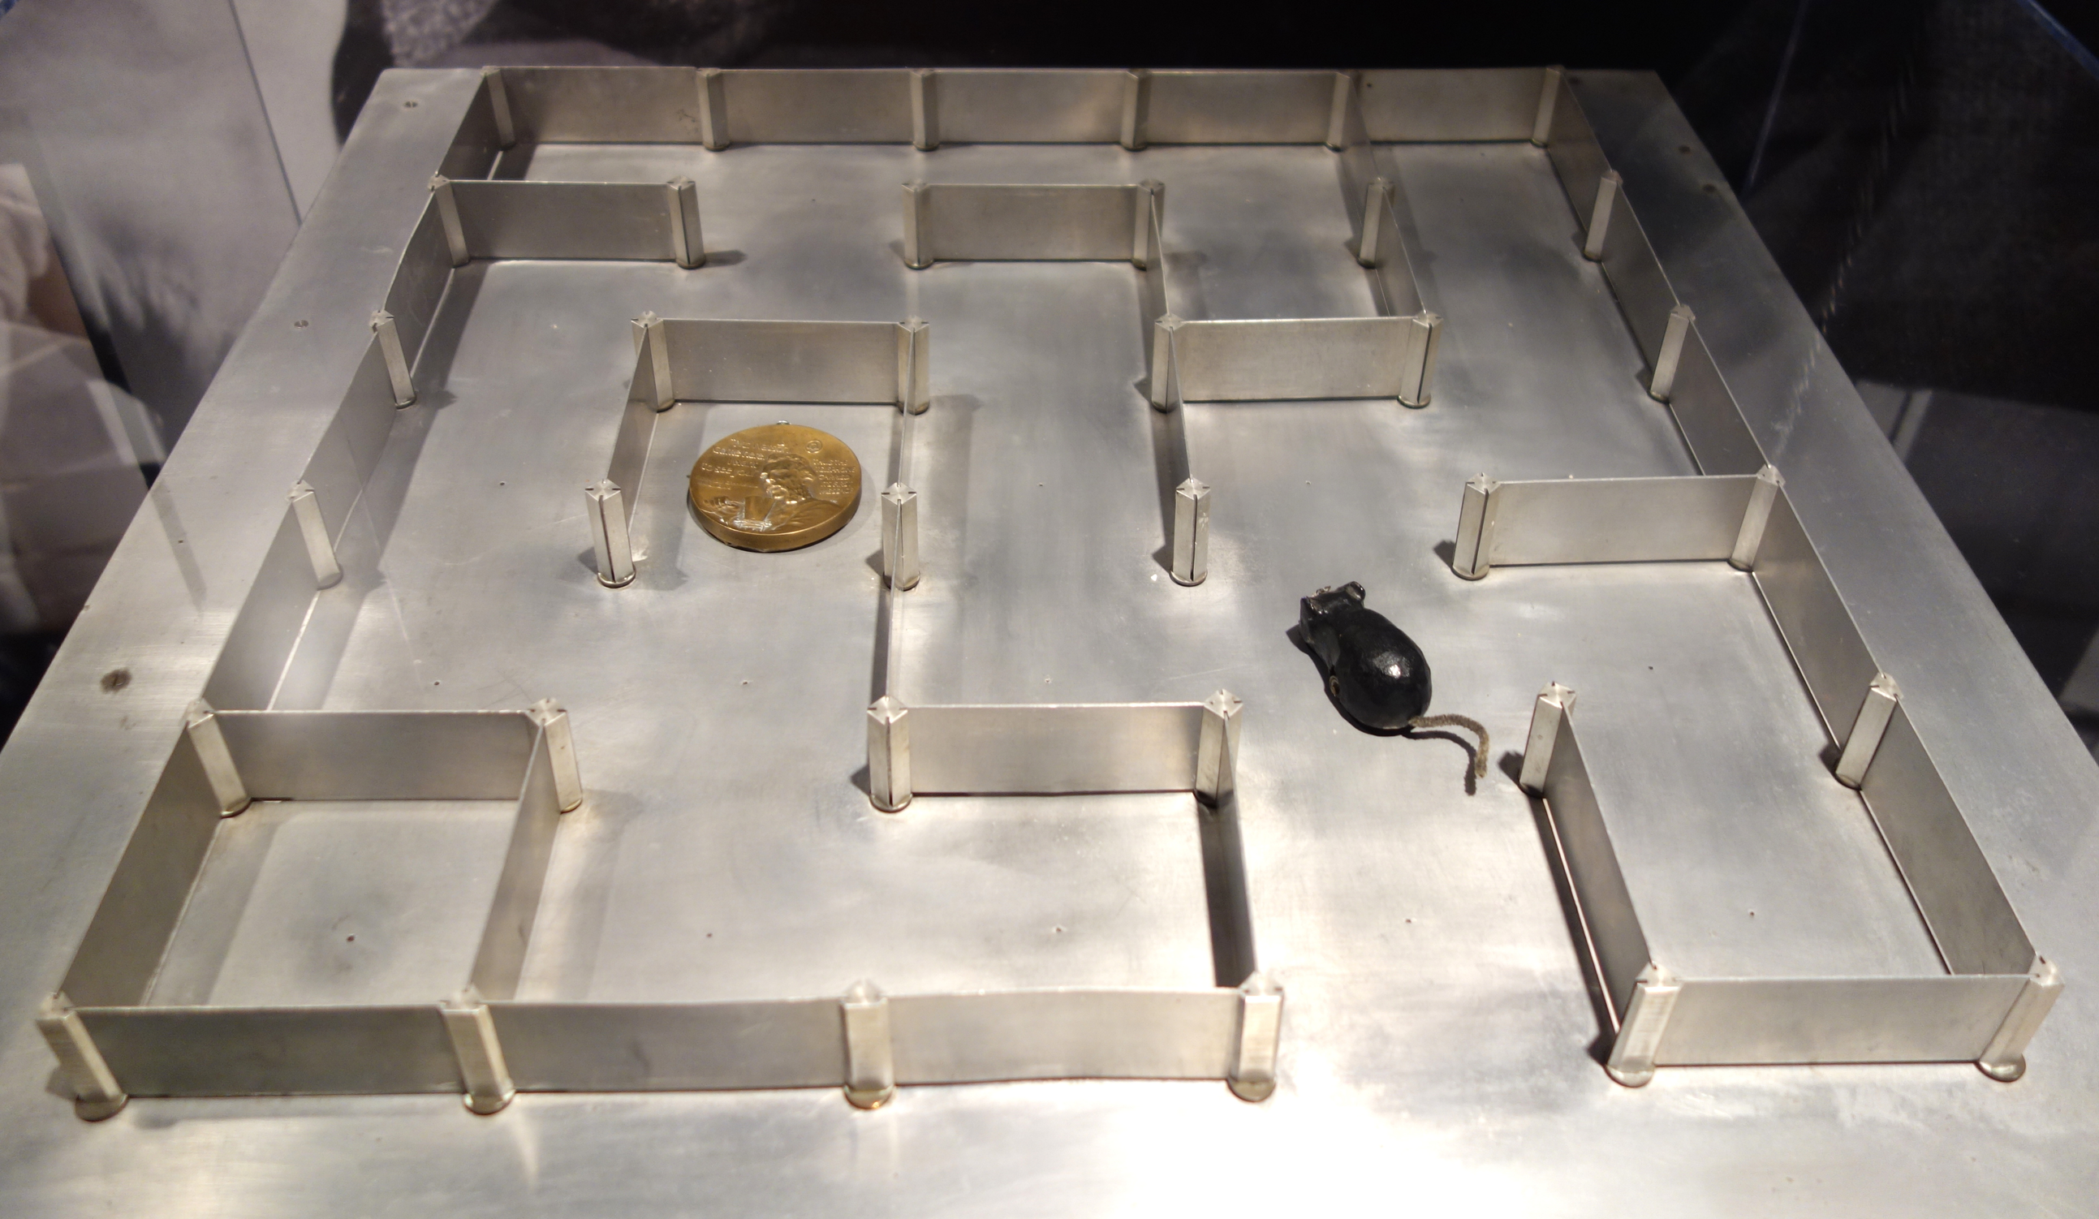
Micromouse Maze Solver with Reinforcement Learning
Using RL to train a virtual Micromouse to navigate a randomly generated 20x20 maze optimally.
by Sarthak Rathi
RE
Notes:
1

Slide 2
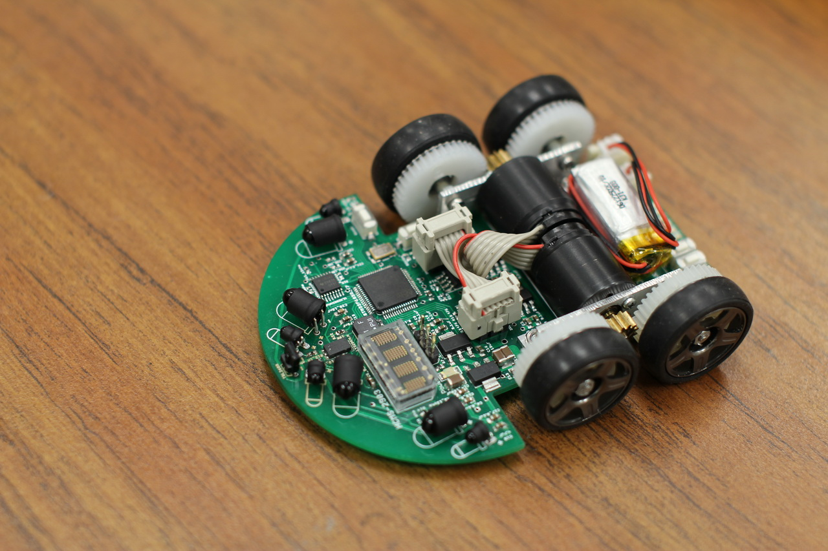
Introduction & Problem Statement
1
Micromouse Challenge
2
Project Simulation
3
Key Skills
Robot finds path from start to goal in a maze.
RL agent learns to solve a 20x20 maze.
Explore unknown environments and optimize path.
Notes:
2

Slide 3





Core Idea: Q-Learning Approach
Q-Learning
Learns optimal policy without environment model.
Actions
Up, down, left, right.
Q-Table
Stores expected reward for each state-action pair.
Rewards
+100 for goal, -10 for wall, -1 per step.
Notes:
3

Slide 4

Implementation Overview
Environment
MicromouseAgent
Training
20x20 maze generated using recursive backtracking.
Q-learning, Q-table of 400 states x 4 actions.
1000 episodes, exploration decaying from 1.0 to 0.01.
Notes:
4

Slide 5
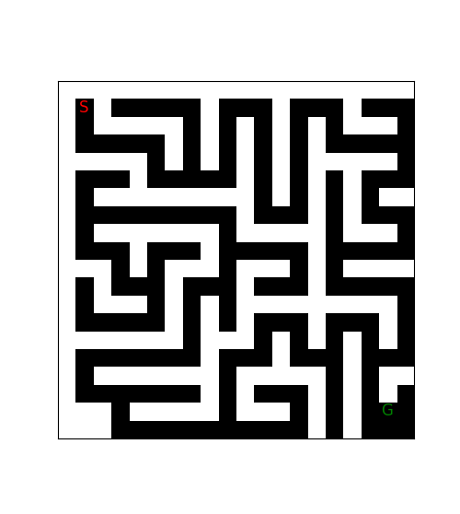
Demonstration & Results
Initial Maze
20x20 maze, start at (1, 1), goal at (18, 18).
Notes:
5

Slide 6
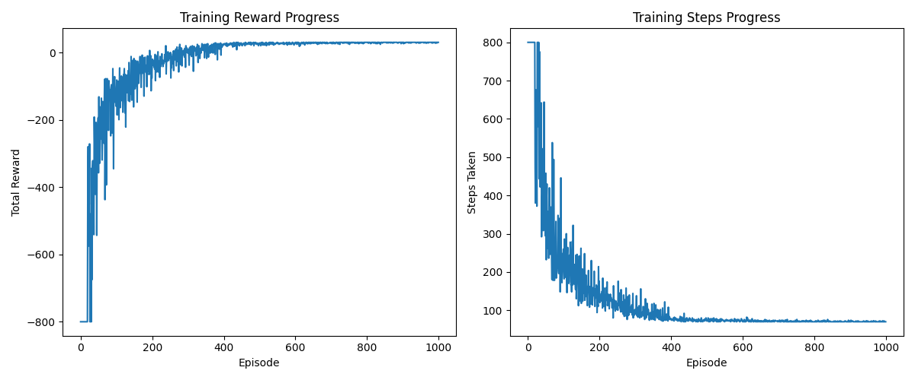
Demonstration & Results
Training Plots
Rewards rising, steps dropping.
Notes:
5

Slide 7
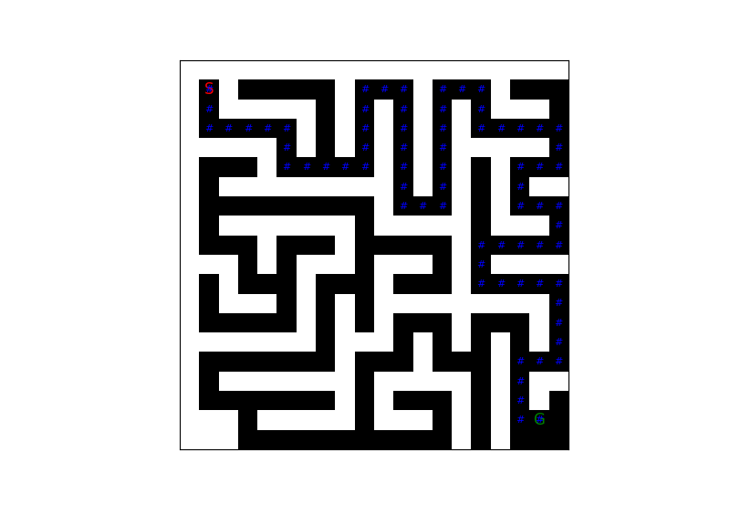
Demonstration & Results
Test Path
Avg steps: 70.4,
Avg reward: 30.6,
BFS: 70.
Notes:
5

Slide 8
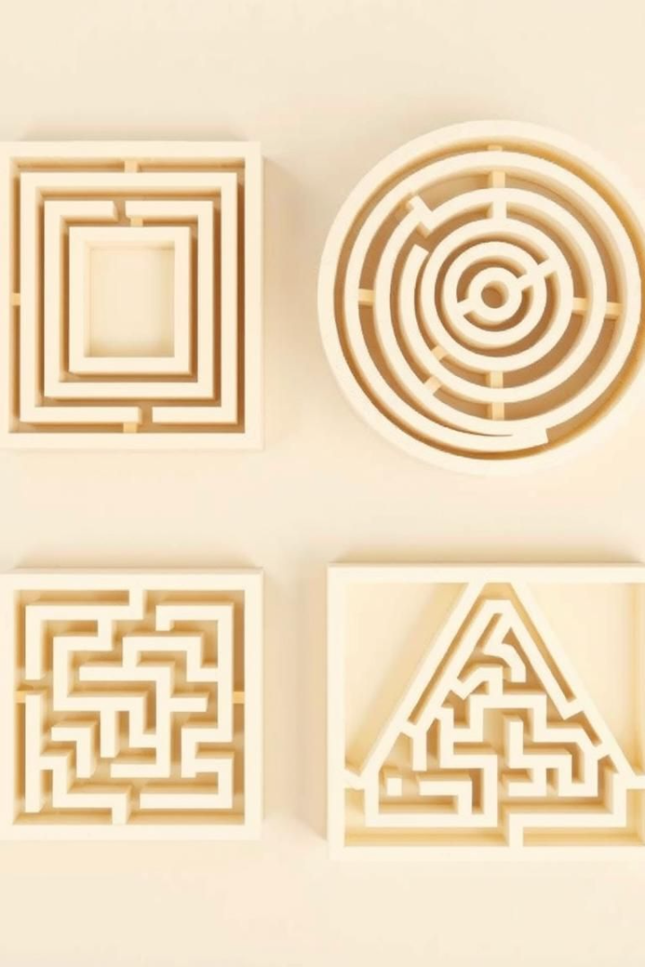
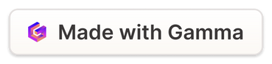
Limitations & Future Work
1
Tabular Q-Learning Limitations
Agent is tied to the specific maze.
2
Retraining Requirement
New maze layout requires retraining from scratch.
3
Deep Q-Network (DQN) Solution
Train a generalizable agent to solve any maze.
4
Adaptability
Adapts to unseen mazes without retraining.
Notes:
6

Slide 9
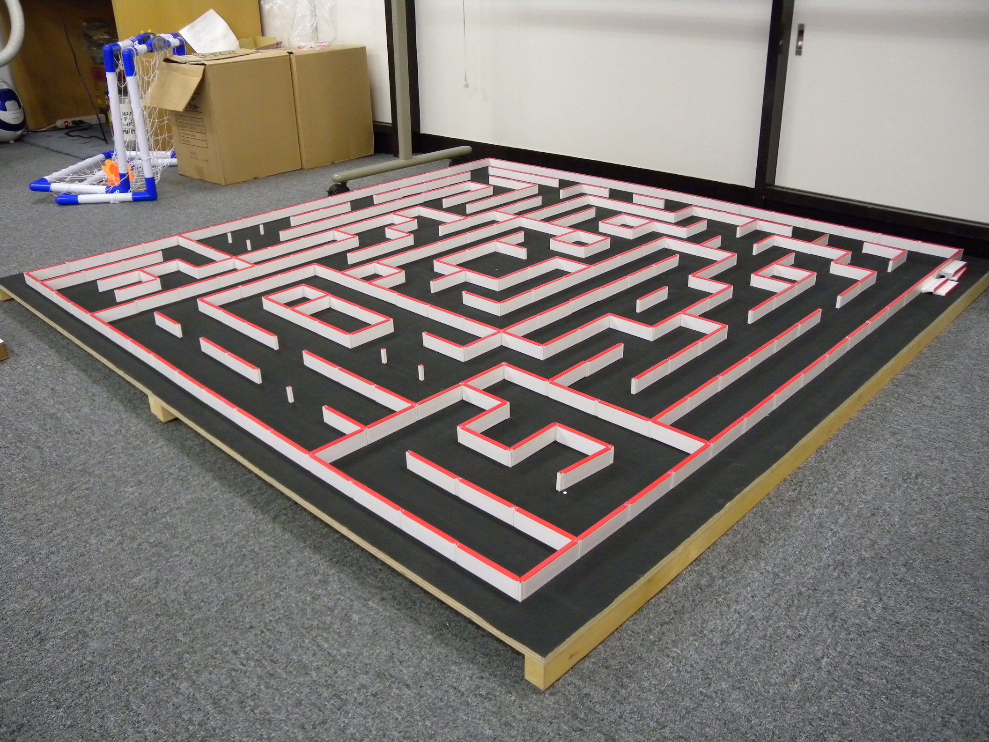
Conclusion
1
Q-Learning Power
2
Adaptive Robotics
Solving Micromouse maze, near-optimal performance.
Solid step toward adaptive robotics.
3
Future Generalization
Exciting potential for generalization.
Notes:
7

